Slide 1


SYSTEMS FOR AUTONOMOUS AIRCRAFT FINAL PROJECT 2025-2026
CAMERA CALIBRATION
PROJECT GUIDE: Prof. ROBERTO OPROMOLLA

Slide 2
Camera Specs which camera?
Sensor Resolution: 50 MP
Aperture: f/1.4.
Sensor Size: 1/1.55“
Pixel Size: 1.0µm (2.0µm with Quad Pixel Technology)
Focal Length: 25mm (35mm equivalent)
Focus Technology: Multi-directional PDAF (Phase Detection Auto Focus) + Laser AF
Stabilization: OIS (Optical Image Stabilization)
Color Validation: Pantone™ Validated (True-to-life color and skin tone accuracy)

Slide 3

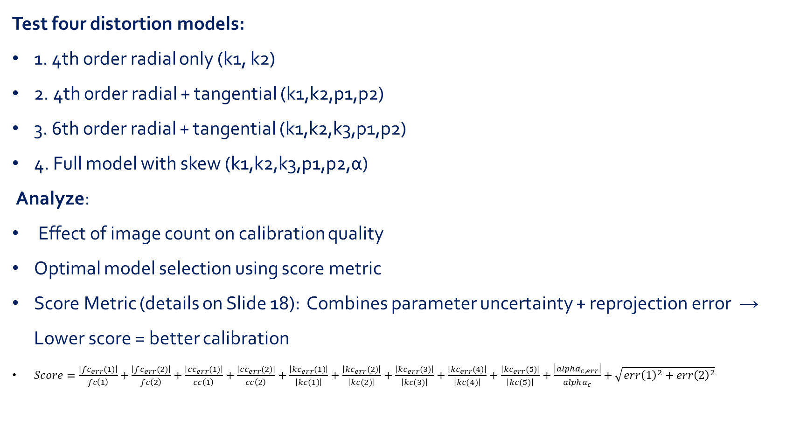
PROBLEM STATEMENT
Test four distortion models:
1. 4th order radial only (k1, k2)
2. 4th order radial + tangential (k1,k2,p1,p2)
3. 6th order radial + tangential (k1,k2,k3,p1,p2)
4. Full model with skew (k1,k2,k3,p1,p2,α)
Analyze:
Effect of image count on calibration quality
Optimal model selection using score metric
Score Metric (details on Slide 18): Combines parameter uncertainty + reprojection error → Lower score = better calibration
$Score=\frac{\left|fc_{err}(1)\right|}{fc\left(1\right)}+\frac{\left|fc_{err}(2)\right|}{fc\left(2\right)}+\frac{\left|cc_{err}(1)\right|}{cc\left(1\right)}+\frac{\left|cc_{err}(2)\right|}{cc\left(2\right)}+\frac{\left|{kc}_{err}(1)\right|}{\left|kc(1)\right|}+\frac{\left|{kc}_{err}(2)\right|}{\left|kc(2)\right|}+\frac{\left|{kc}_{err}(3)\right|}{\left|kc(3)\right|}+\frac{\left|{kc}_{err}(4)\right|}{\left|kc(4)\right|}+\frac{\left|{kc}_{err}(5)\right|}{\left|kc(5)\right|}+\frac{\left|{alpha}_{c,err}\right|}{alpha_{c}}+\sqrt{err{\left(1\right)}^{2}+err{\left(2\right)}^{2}}$
- For each model, report:
Intrinsic parameters + uncertainties (σ)
Extrinsic parameters (R, t for each image)
Reprojection errors (per image + mean)

Slide 4
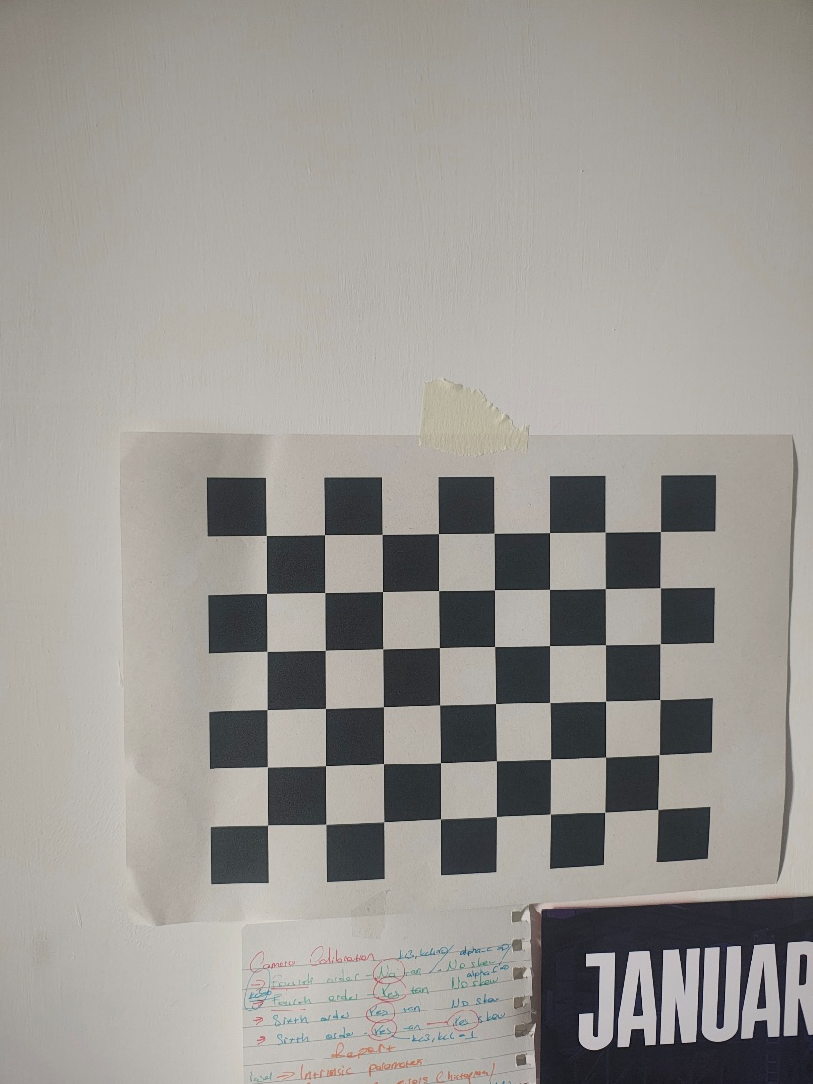
INTRODUCTION
A planar checkerboard with known square size is used. For each image, the corner points are detected in the image and associated with known 3D coordinates in the checkerboard reference frame.
The calibration problem is solved by minimizing the reprojection error using nonlinear least squares.
A checkerboard with square size 25 mm was used.
A total of 21 usable images were acquired with different orientations and positions.

Slide 5
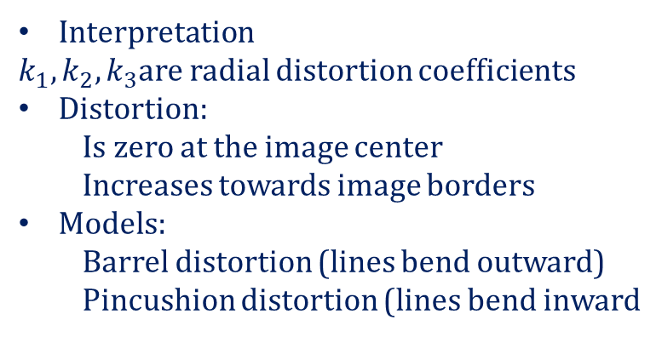
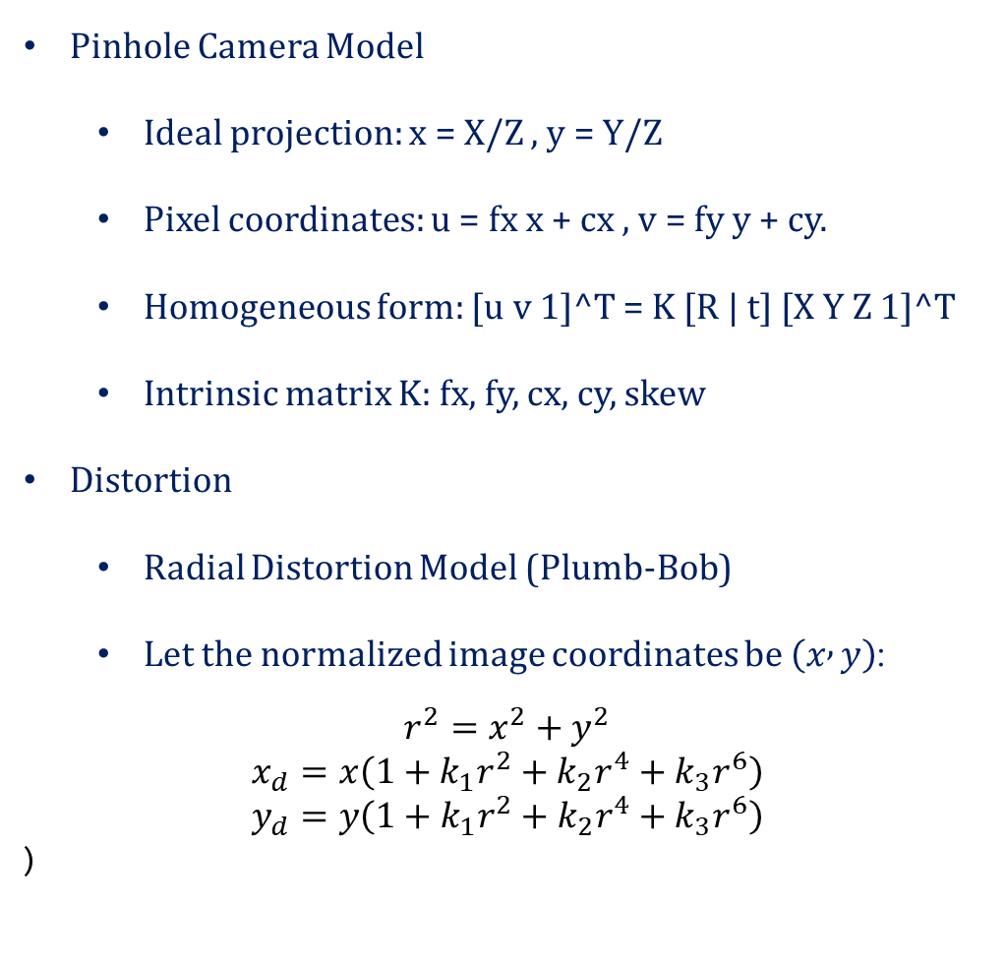
METHODOLOGY
Pinhole Camera Model
Ideal projection: x = X/Z , y = Y/Z
Pixel coordinates: u = fx x + cx , v = fy y + cy.
Homogeneous form: [u v 1]^T = K [R | t] [X Y Z 1]^T
Intrinsic matrix K: fx, fy, cx, cy, skew
Distortion
Radial Distortion Model (Plumb-Bob)
Let the normalized image coordinates be $\left(x , y\right)$:
$$r^{2}=x^{2}+y^{2}$$
$$x_{d}=x\left(1+k_{1}r^{2}+k_{2}r^{4}+k_{3}r^{6}\right)$$
$$y_{d}=y\left(1+k_{1}r^{2}+k_{2}r^{4}+k_{3}r^{6}\right)$$
)
Interpretation
$k_{1},k_{2},k_{3}$are radial distortion coefficients
Distortion:
Is zero at the image center
Increases towards image borders
Models:
Barrel distortion (lines bend outward)
Pincushion distortion (lines bend inward

Slide 6
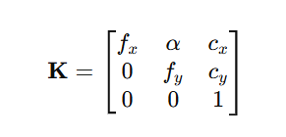
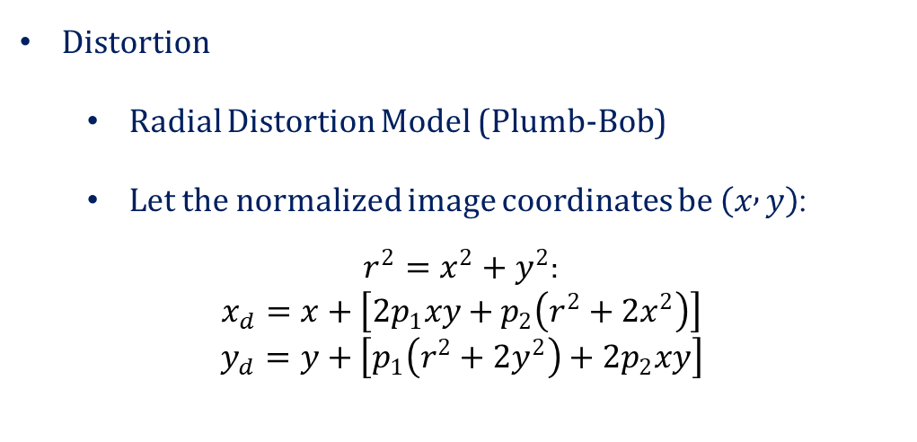
METHODOLOGY
Distortion
Radial Distortion Model (Plumb-Bob)
Let the normalized image coordinates be $\left(x , y\right)$:
$r^{2}=x^{2}+y^{2}$:
$$x_{d}=x+\left[2p_{1}xy+p_{2}\left(r^{2}+2x^{2}\right)\right]$$
$$y_{d}=y+\left[p_{1}\left(r^{2}+2y^{2}\right)+2p_{2}xy\right]$$
SKEW
Skew represents non-orthogonality between the image x and y axes
It appears when:
Pixels are not perfectly rectangular
The sensor axes are not exactly perpendicular
p1​,p2 ​ = tangential distortion coefficients
Distortion is usually much smaller than radial distortion
Depends on lens alignment, not lens shape

Slide 7
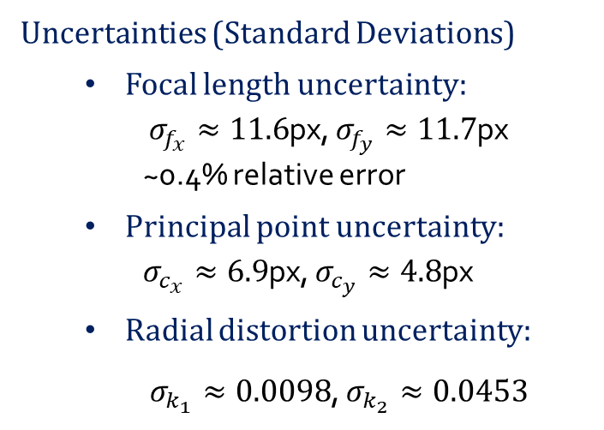
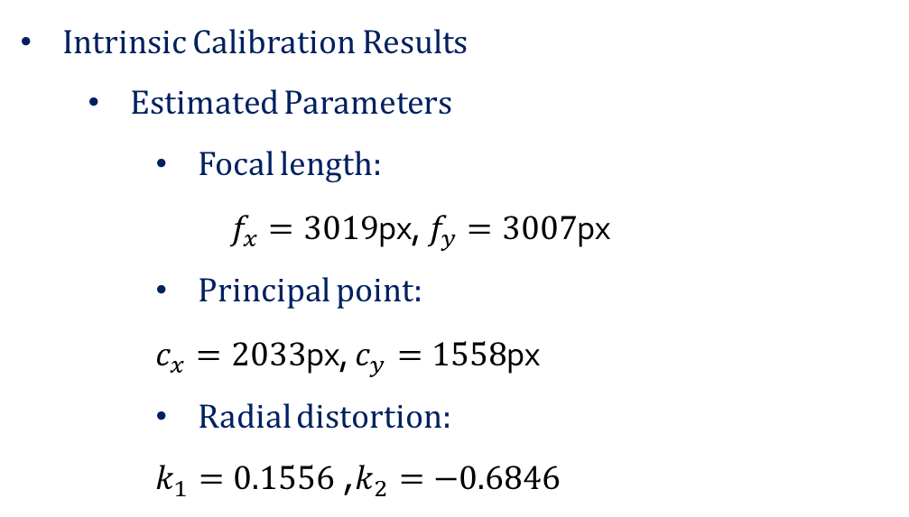
CALIBRATION
4th order radial, no tangential, no skew
Intrinsic Calibration Results
Estimated Parameters
Focal length:
$f_{x}=3019$px, $f_{y}=3007$px
Principal point:
$c_{x}=2033$px, $c_{y}=1558$px
Radial distortion:
$k_{1}=0.1556$, $k_{2}=−0.6846$
Uncertainties (Standard Deviations)
Focal length uncertainty:
$σ_{f_{x}}≈11.6$px, $σ_{f_{y}}≈11.7$px ~0.4% relative error
Principal point uncertainty:
$σ_{c_{x}}≈6.9$px, $σ_{c_{y}}≈4.8$px
Radial distortion uncertainty:
$σ_{k_{1}}≈0.0098$, $σ_{k_{2}}≈0.0453$

Slide 8

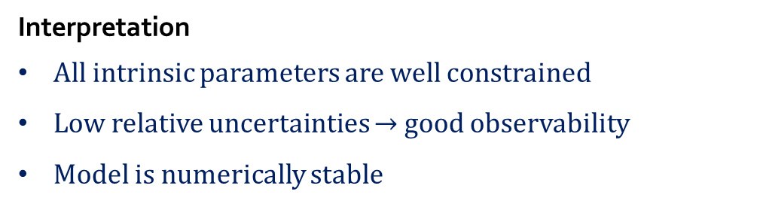
Parameter | Value | σ | σ/val
fx (px) | 3019 | 11.6 | 0.4%
fy (px) | 3007 | 11.7 | 0.4%
cx (px) | 2033 | 6.9 | 0.3%
cy (px) | 1558 | 4.8 | 0.3%
k1 | 0.1556 | 0.0098 | 6.3%
k2 | -0.6846 | 0.0453 | 6.6%

Slide 9
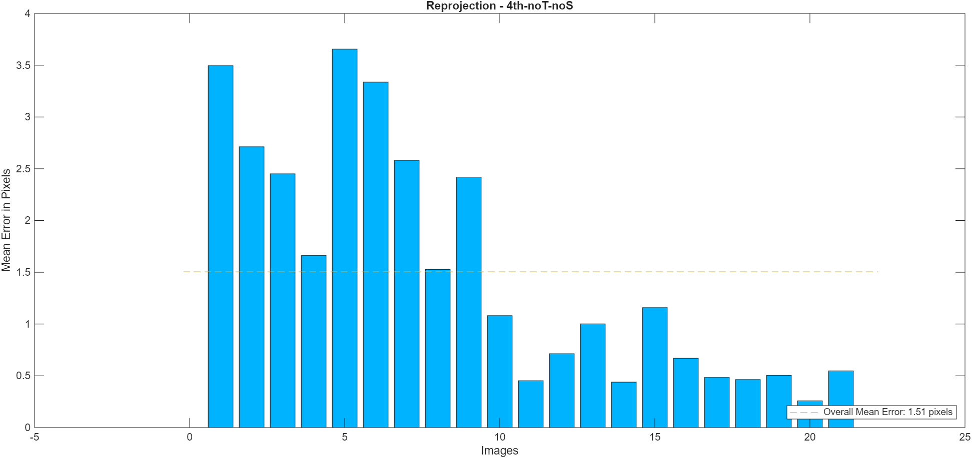
CALIBRATION
4th order radial, no tangential, no skew
Mean error: 1.51 px (RMS over all corners, all images)
Per-image distribution:
Best: 0.26 px (sharp, well-lit, frontal view)
Worst: 3.65 px (blur, extreme angle, or occlusion)

Slide 10
CALIBRATION
Error Range | #Images | %
< 1.0 px | 8 | 38%
1.0-2.0 px | 9 | 43%
2.0-3.0 px | 3 | 14%
> 3.0 px | 1 | 5%
Interpretation
Calibration is globally consistent
A few low-quality images dominate the mean error
No catastrophic outliers → dataset is stable
So, Accuracy is acceptable but limited by:
Image quality
Symmetric checker board
Corner detection accuracy

Slide 11
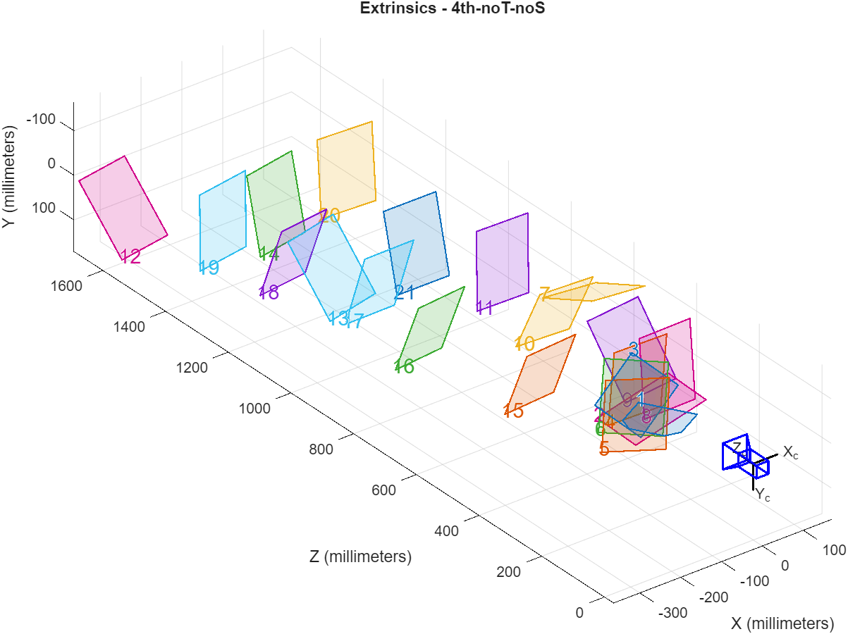
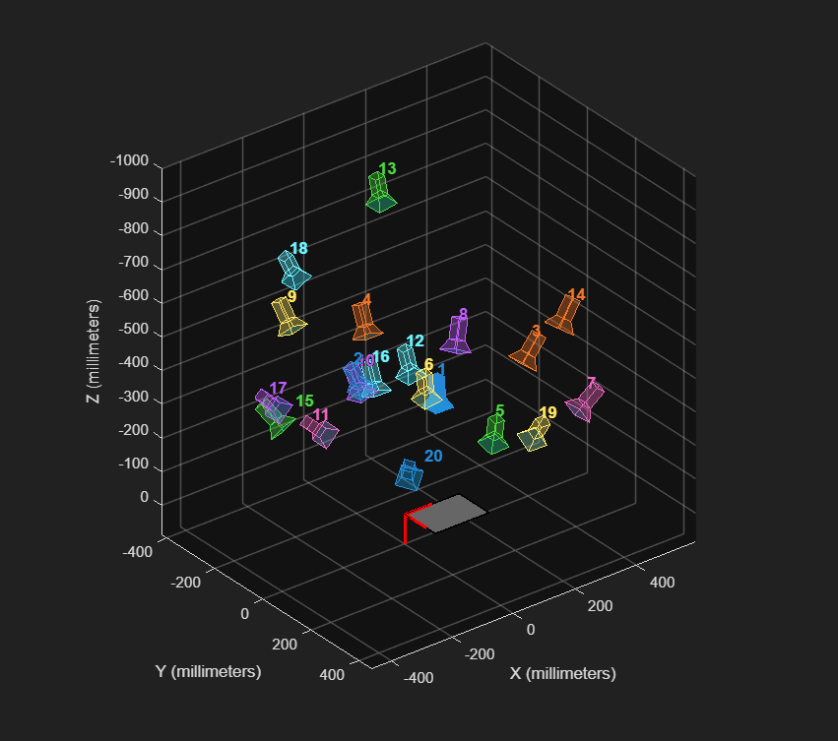
CALIBRATION
4th order radial, no tangential, no skew
Extrinsic Parameters
Camera poses cover:
Different distances (Z direction)
Different orientations (tilted views)
Different lateral positions (X, Y)
This geometric diversity is essential for good calibration
Interpretation
The wide spread of poses:
Improves parameter observability
Reduces parameter correlation
No degenerate configuration:
No all images from same position
No all images fronto-parallel

Slide 12
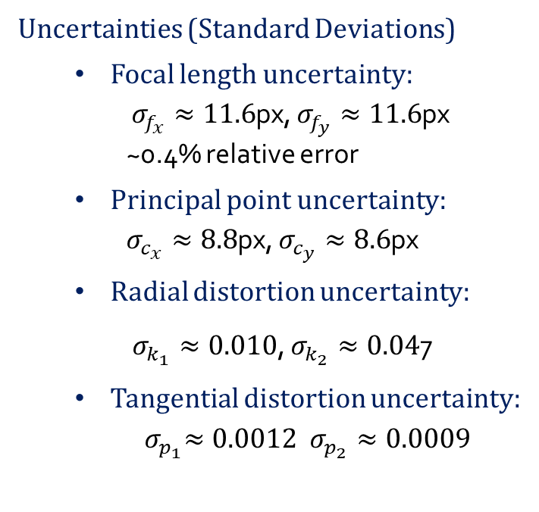
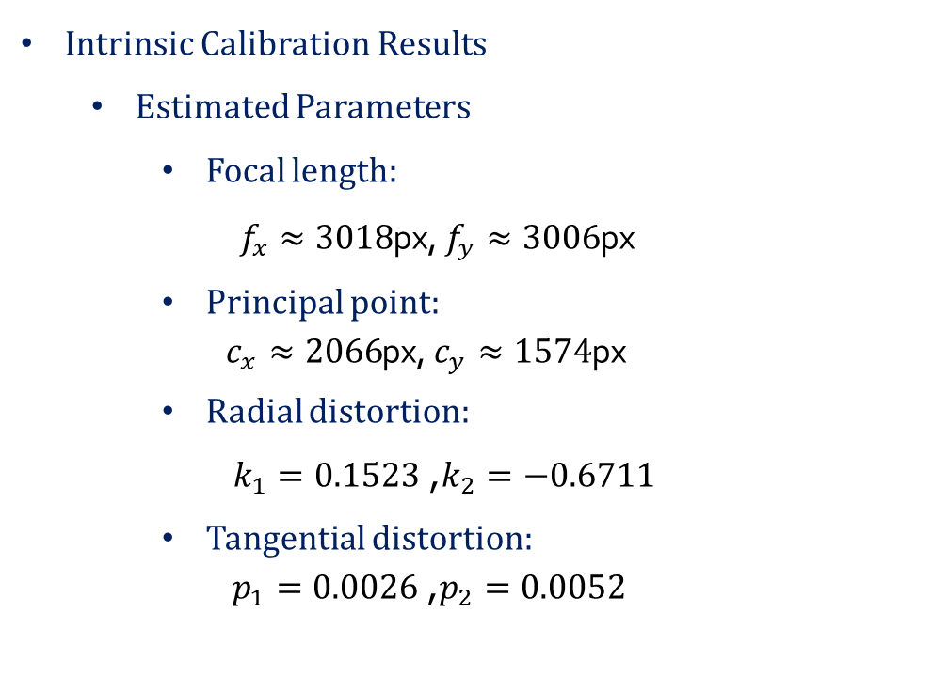
CALIBRATION
Uncertainties (Standard Deviations)
Focal length uncertainty:
$σ_{f_{x}}≈11.6$px, $σ_{f_{y}}≈11.6$px ~0.4% relative error
Principal point uncertainty:
$σ_{c_{x}}≈8.8$px, $σ_{c_{y}}≈8.6$px
Radial distortion uncertainty:
$σ_{k_{1}}≈0.010$, $σ_{k_{2}}≈0.04$7
Tangential distortion uncertainty:
$${ σ}_{p_{1}}≈0.0012 σ_{p_{2}}≈0.0009$$
4th order radial, tangential, no skew
Intrinsic Calibration Results
Estimated Parameters
Focal length:
$f_{x}≈3018$px, $f_{y}≈3006$px
Principal point:
$c_{x}≈2066$px, $c_{y}≈1574$px
Radial distortion:
$k_{1}=0.1523$, $k_{2}=−0.6711$
Tangential distortion:
$p_{1}=0.0026$, $p_{2}=0.0052$
Interpretation
Focal length and principal point are well estimated and stable
Radial distortion coefficients are well constrained
Tangential distortion: Small magnitude
Uncertainty is of the same order → weakly observable
Overall calibration is numerically stable

Slide 13
Comparison: Model 1 vs Model 2
Parameter | Model 1 | Model 2 | Δ Change
cx (px) | 2033 | 2066 | +33 px
cy (px) | 1558 | 1574 | +16 px
k1 | 0.1556 | 0.1523 | -2.1%
k2 | -0.6846 | -0.6711 | -2.0%
σ_cx (px) | 6.9 | 8.8 | +27%
Interpretation
Tangential terms slightly alter distortion model
Uncertainties increase (decorrelation) → GOOD
Mean error unchanged (1.51 px) → No improvement

Slide 14
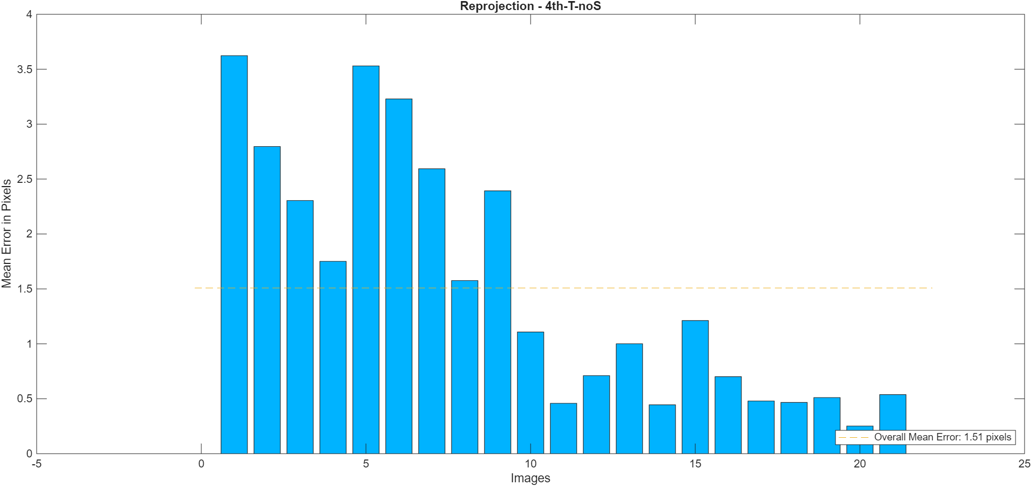
CALIBRATION
4th order radial, tangential, no skew
Intrinsic Calibration Results
Reprojection error is not uniform across images
Some images show large errors (~3–3.6 px):Likely due to blur, poor lighting, or extreme perspective
Many images show small errors (< 1 px):Good quality and well-conditioned views
Final mean reprojection error ≈ 1.5 pixels
Interpretation
Calibration is globally consistent
A few low-quality images dominate the mean error
No catastrophic outliers → dataset is stable

Slide 15
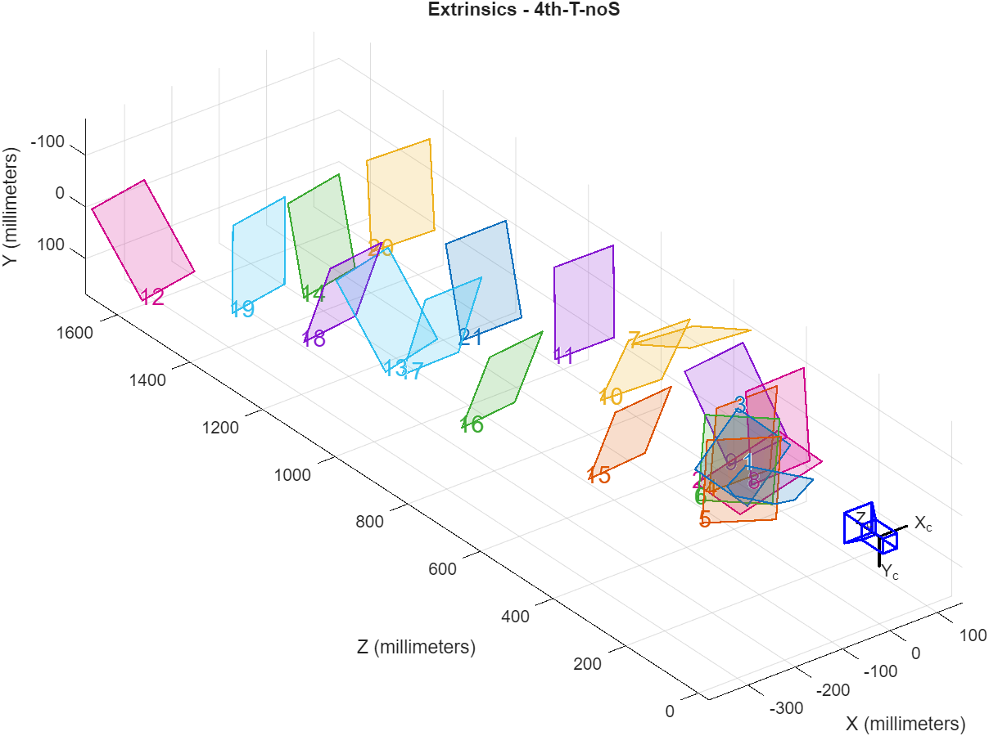
CALIBRATION
4th order radial, tangential, no skew
Extrinsic Parameters
Camera poses cover:
Different distances (Z direction)
Different orientations (tilted views)
Different lateral positions (X, Y)
This geometric diversity is essential for good calibration
Interpretation
The wide spread of poses:
Improves parameter observability
Reduces parameter correlation
No degenerate configuration:
No all images from same position
No all images fronto-parallel

Slide 16
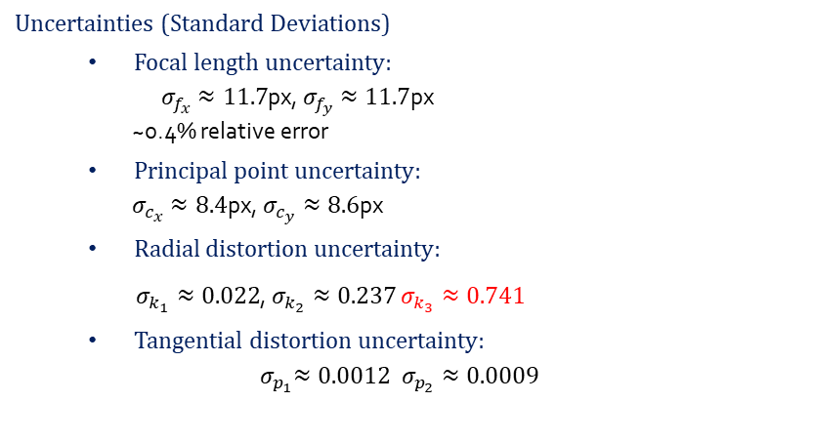
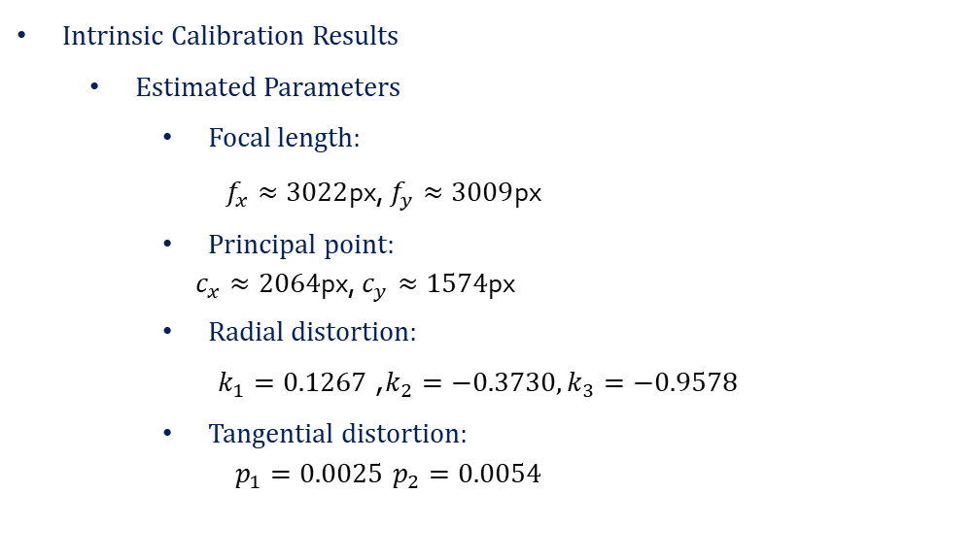
CALIBRATION
6th order radial, tangential, no skew
Intrinsic Calibration Results
Estimated Parameters
Focal length:
$f_{x}≈3022$px, $f_{y}≈3009$px
Principal point:
$c_{x}≈2064$px, $c_{y}≈1574$px
Radial distortion:
$k_{1}=0.1267$, $k_{2}=−0.3730,k_{3}=−0.9578$
Tangential distortion:
$p_{1}=0.0025$ $p_{2}=0.0054$
Interpretation
Focal length and principal point are stable
But: 𝑘_2and 𝑘_3 have huge uncertainties
𝑘_3=−0.95±0.74 This means,
The parameter is poorly observable
This is a clear sign of overfitting
Tangential distortion is weakly observable
This model is over-parameterized
Uncertainties (Standard Deviations)
Focal length uncertainty:
$σ_{f_{x}}≈11.7$px, $σ_{f_{y}}≈11.7$px ~0.4% relative error
Principal point uncertainty:
$σ_{c_{x}}≈8.4$px, $σ_{c_{y}}≈8.6$px
Radial distortion uncertainty:
$σ_{k_{1}}≈0.022$, $σ_{k_{2}}≈0.237$ $σ_{k_{3}}≈0.741$
Tangential distortion uncertainty:
$${ σ}_{p_{1}}≈0.0012 σ_{p_{2}}≈0.0009$$

Slide 17

CALIBRATION
6th order radial, tangential, no skew
Reprojection error distribution is very similar to simpler models:
Some images: ~3–3.6 px
Many images: < 1 px
Global mean error is almost identical to:
4th-noT-no
S4th-T-noS
Interpretation
Despite more parameters (k₁, k₂, k₃ + p₁, p₂),The reprojection error does not improve

Slide 18
CALIBRATION
6th order radial, tangential, no skew
Extrinsic Parameters
Camera poses cover:
Different distances (Z direction)
Different orientations (tilted views)
Different lateral positions (X, Y)
This geometric diversity is essential for good calibration
Interpretation
Good geometric diversity is present:
This is necessary for reliable calibration
The pose distribution is very similar to the simpler models:
The complex distortion model does not change camera geometry

Slide 19
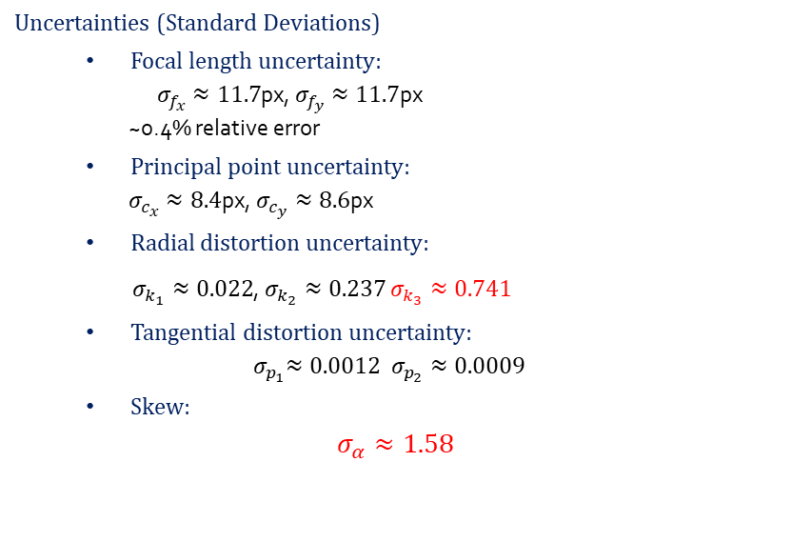
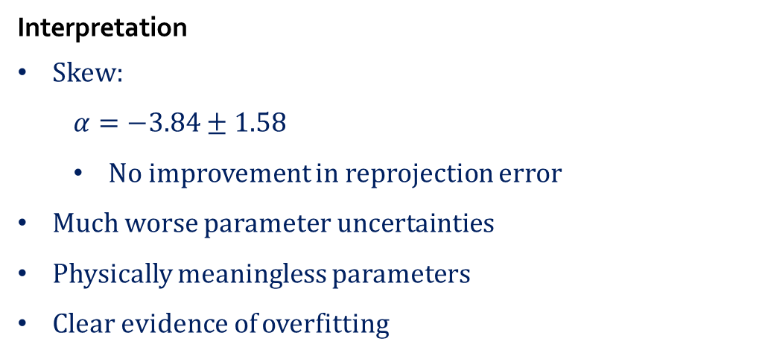
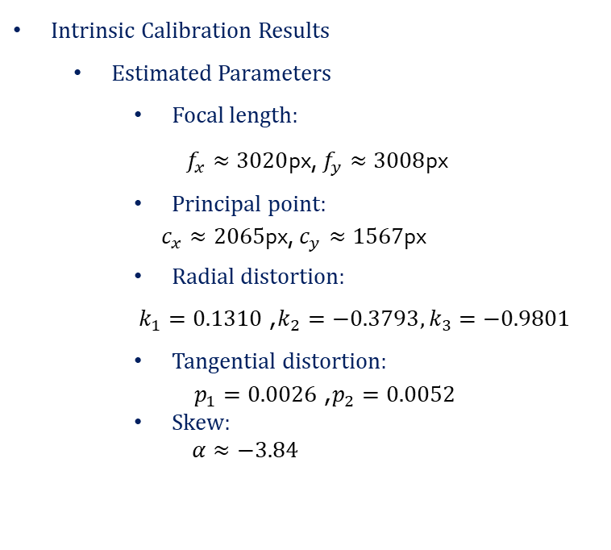
CALIBRATION
6th order radial, tangential, skew
Uncertainties (Standard Deviations)
Focal length uncertainty:
$σ_{f_{x}}≈11.7$px, $σ_{f_{y}}≈11.7$px ~0.4% relative error
Principal point uncertainty:
$σ_{c_{x}}≈8.4$px, $σ_{c_{y}}≈8.6$px
Radial distortion uncertainty:
$σ_{k_{1}}≈0.022$, $σ_{k_{2}}≈0.237$ $σ_{k_{3}}≈0.741$
Tangential distortion uncertainty:
$${ σ}_{p_{1}}≈0.0012 σ_{p_{2}}≈0.0009$$
Skew:
$$σ_{α}≈1.58$$
Intrinsic Calibration Results
Estimated Parameters
Focal length:
$f_{x}≈3020$px, $f_{y}≈3008$px
Principal point:
$c_{x}≈2065$px, $c_{y}≈1567$px
Radial distortion:
$k_{1}=0.1310$, $k_{2}=−0.3793,k_{3}=−0.9801$
Tangential distortion:
$p_{1}=0.0026$, $p_{2}=0.0052$
Skew:
$$α≈−3.84$$
Interpretation
Skew:
$α=−3.84±1.58$
No improvement in reprojection error
Much worse parameter uncertainties
Physically meaningless parameters
Clear evidence of overfitting

Slide 20
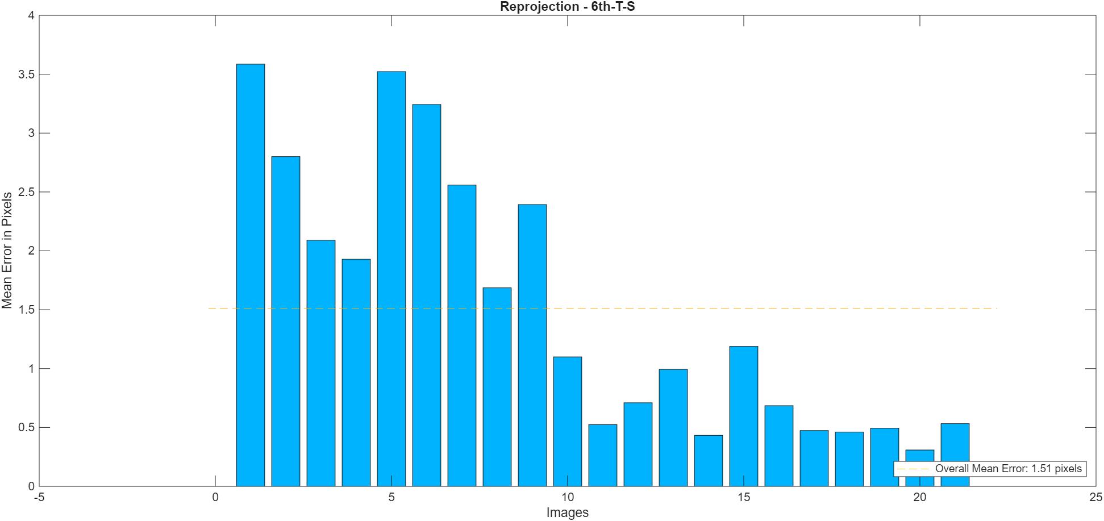
CALIBRATION
6th order radial, tangential, skew
Intrinsic Calibration Results
Reprojection error is not uniform across images
Some images show large errors (~3–3.6 px):Likely due to blur, poor lighting, or extreme perspective
Many images show small errors (< 1 px):Good quality and well-conditioned views
Final mean reprojection error ≈ 1.5 pixels
Interpretation
Despite3 radial coefficients, Tangential distortion, Skew the reprojection error does not improve at all

Slide 21

IMAGE COUNT ANALYSIS
Number of Images | Mean Reprojection Error | σ_fx (px) | Selection Strategy
3 | 2.45 px | 18.2 | Diverse pose
5 | 2.74 px | 15.6 | Random
7 | 2.84 px | 14.1 | Random
10 | 2.49 px | 13.3 | Random
21 | 1.51 px | 11.6 | All images
Uncertainty (σ_fx) DOES decrease monotonically
More images = more stable estimation
Error does NOT decrease monotonically
Image QUALITY matters more than QUANTITY

Slide 22
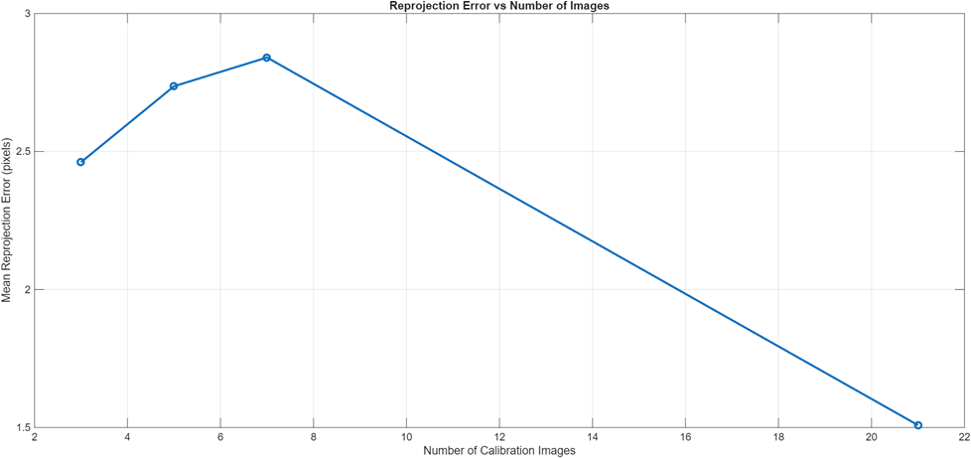
IMAGE COUNT ANALYSIS
With few images:
Poor geometric coverage
Poor parameter observability
Large reprojection error
As number of images increases:
Viewpoint diversity increases
Estimation becomes more stable
Error decreases significantly
CONCLUSION:
- Minimum: ~10 images for stable calibration
Optimal: 20-30 high-quality, diverse images
Adding poor images can HURT accuracy!

Slide 23
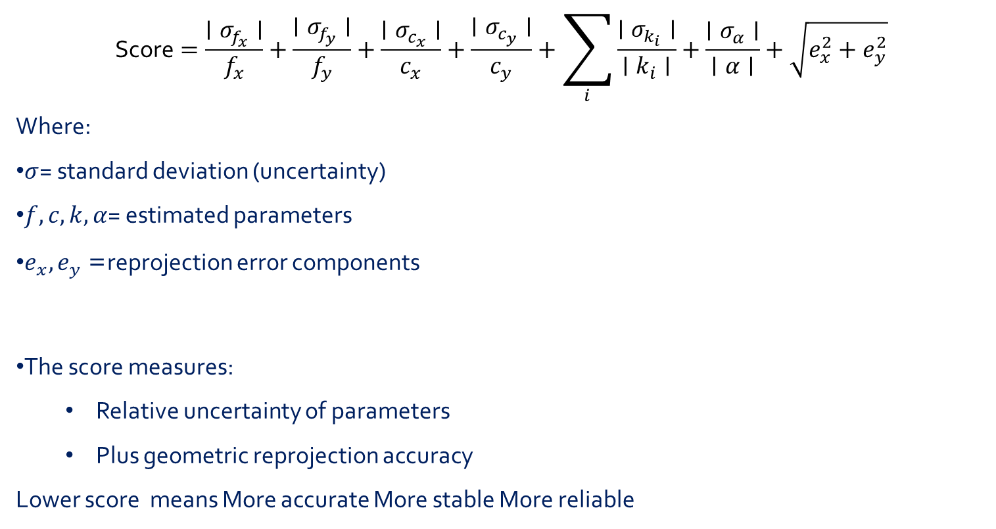
SCORE METRIC
$$\text{Score}=\frac{∣σ_{f_{x}}∣}{f_{x}}+\frac{∣σ_{f_{y}}∣}{f_{y}}+\frac{∣σ_{c_{x}}∣}{c_{x}}+\frac{∣σ_{c_{y}}∣}{c_{y}}+\sum_{i}{\frac{∣σ_{k_{i}}∣}{∣k_{i}∣}}+\frac{∣σ_{α}∣}{∣α∣}+\sqrt{e_{x}^{2}+e_{y}^{2}}$$
Where:
$σ$= standard deviation (uncertainty)
$f,c,k,α$= estimated parameters
$e_{x},e_{y}$= reprojection error components
The score measures:
Relative uncertainty of parameters
Plus geometric reprojection accuracy
Lower score means More accurate More stable More reliable

Slide 24
SCORE METRIC
Performance Score Comparison Between Models
Model | Omnivision 50 MP Score | Samsung 12MP Score
4th-noT-noS | 1.65 | 1.38
4th-T-noS | 1.66 | 2.21
6th-T-noS | 3.11 | 2.95
6th-T-S | `3.51 | 3.55
CONCLUSION: The 4th-noT-noS model is the best compromise between accuracy and stability.

Slide 25

THANK YOU

